Slide 1

{{TITLE}}
{{SUBTITLE}}

Slide 2
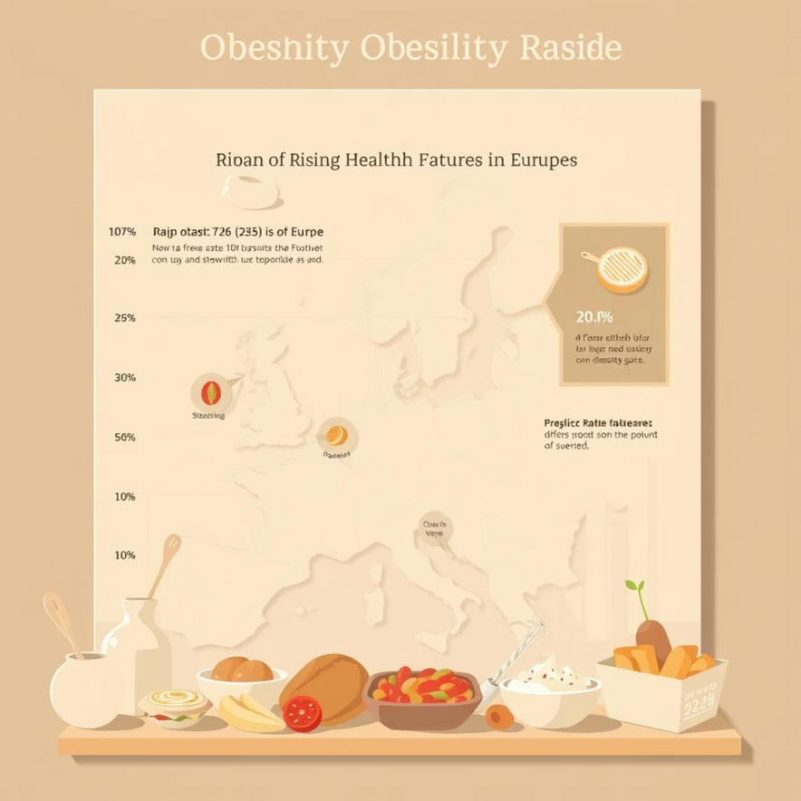
{{TITLE}}
{{TITLE}}
{{BODY}}
{{TITLE}}
{{BODY}}
{{TITLE}}
{{BODY}}

Slide 3

{{TITLE}}
{{TITLE}}
{{BODY}}
{{TITLE}}
{{BODY}}

Slide 4





{{TITLE}}
{{TITLE}}
{{BODY}}
{{BODY}}
{{BODY}}
{{BODY}}
{{BODY}}
{{BODY}}
{{BODY}}

Slide 5






{{TITLE}}
{{TITLE}}
{{TITLE}}
{{BODY}}
{{BODY}}
{{TITLE}}
{{TITLE}}
{{BODY}}
{{BODY}}
{{TITLE}}
{{TITLE}}
{{BODY}}
{{BODY}}
{{BODY}}

Slide 6

{{TITLE}}
{{TITLE}}
{{BODY}}
{{BODY}}
{{TITLE}}
{{BODY}}
{{BODY}}
{{TITLE}}
{{BODY}}
{{BODY}}

Slide 7

{{TITLE}}
{{TITLE}}
{{TITLE}}
{{BODY}}
{{BODY}}
{{BODY}}
{{TITLE}}
{{BODY}}
This suggests that promoting access to and consumption of diverse, healthier culinary options can be a strategic public health intervention.

Slide 8

{{TITLE}}
{{TITLE}}
{{BODY}}
{{TITLE}}
{{BODY}}
{{TITLE}}
{{BODY}}
{{BODY}}

Slide 9
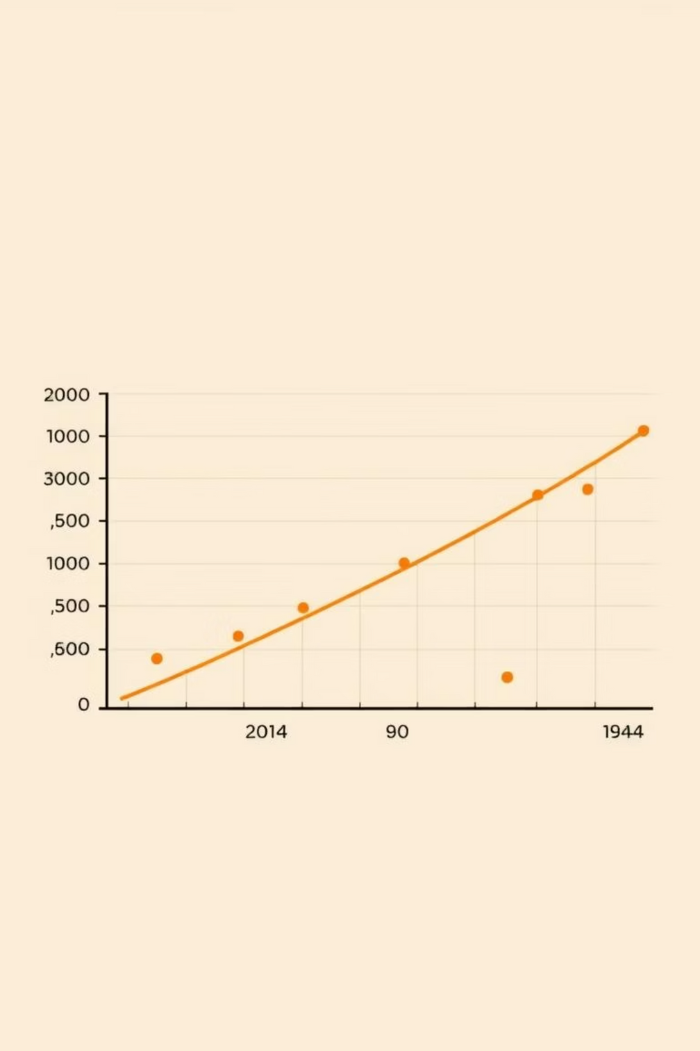



{{TITLE}}
{{TITLE}}
{{BODY}}
{{TITLE}}
{{BODY}}
{{TITLE}}
{{BODY}}
{{BODY}}
{{BODY}}

Slide 10



{{TITLE}}
1
{{TITLE}}
{{TITLE}}
{{BODY}}
{{BODY}}
{{BODY}}
2
GDP alone is not a strong indicator of national obesity.
{{TITLE}}
{{BODY}}
{{TITLE}}
3
{{BODY}}
{{TITLE}}
{{BODY}}
{{BODY}}
{{BODY}}

